Slide 1
NHS WIRRAL CCG
Latest survey results
2020 survey publication

Slide 2
Contents
49
Background, introduction and guidance
Overall experience of GP practice
Local GP services
Access to online services
Making an appointment
Perceptions of care at patients’ last appointment
Managing health conditions
Satisfaction with general practice appointment times
Services when GP practice is closed
Statistical reliability
Want to know more?

Slide 3
Background, introduction and guidance

Slide 4
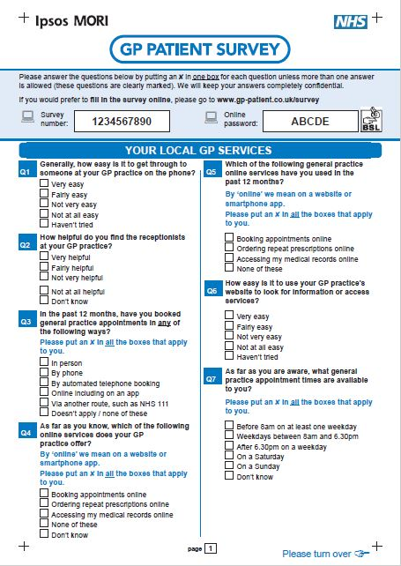
Background information about the survey
The GP Patient Survey (GPPS) is an England-wide survey, providing practice-level data about patients’ experiences of their GP practices.
Ipsos MORI administers the survey on behalf of NHS England.
For more information about the survey please refer to the end of this slide pack or visit https://gp-patient.co.uk/.
This slide pack presents some of the key results for NHS WIRRAL CCG.
The data in this slide pack are based on the 2020 GPPS publication.
In NHS WIRRAL CCG, 17,479 questionnaires were sent out, and 5,487 were returned completed. This represents a response rate of 31%.
In 2018 the questionnaire was redeveloped in response to significant changes to primary care services as set out in the GP Forward View, and to provide a better understanding of how local care services are supporting patients to live well, particularly those with long-term care needs. The questionnaire (and past versions) can be found here: https://gp-patient.co.uk/surveysandreports.

Slide 5
Introduction
The GP Patient Survey measures patients’ experiences across a range of topics, including:
  Your local GP services
  Making an appointment
  Your last appointment
  Overall experience
  Your health
  When your GP practice is closed
  NHS Dentistry
  Some questions about you
The GP Patient Survey provides data at practice level using a consistent methodology, which means it is comparable across organisations.
The survey has limitations:
  Sample sizes at practice level are relatively small.
  The survey does not include qualitative data, which limits the detail provided by the results.
The data provide a snapshot of patient experience at a given time, and are updated annually.
There is variation in practice-level response rates, leading to variation in levels of uncertainty around practice-level results. Data users are encouraged to use insight from GPPS as one element of evidence when considering patients' experiences of general practice.
Practices and CCGs can then discuss the findings further and triangulate them with other data – in order to identify potential improvements and highlight best practice.
The following slide suggests ideas for how the data can be used to improve services.
Where available, packs include trend data beginning in 2018. Following the extensive changes to the questionnaire in 2018, all questions at CCG and practice level are not comparable prior to this year.

Slide 6
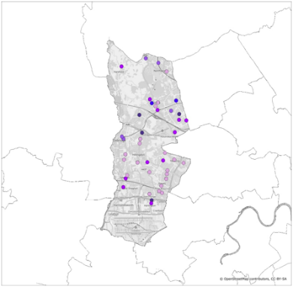
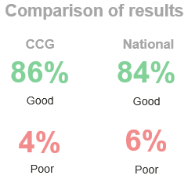
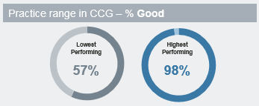
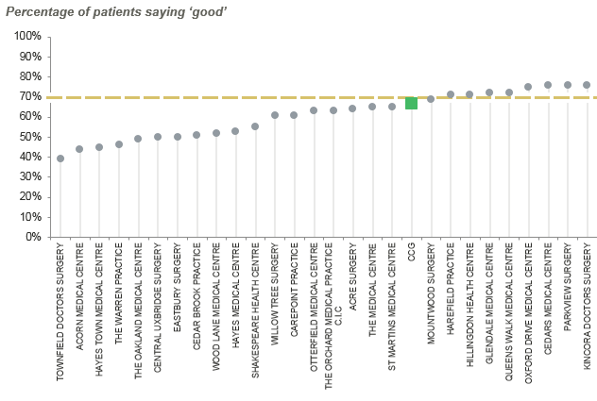
Guidance on how to use the data
*
The following suggest ideas for how the data in this slide pack can be used and interpreted to improve GP services:
  Comparison of a CCG’s results against the national average: this allows benchmarking of the results to identify whether the CCG is performing well, poorly, or in line with others. The CCG may wish to focus on areas where it compares less favourably.
  Considering questions where there is a larger range in responses among practices or CCGs: this highlights areas in which greater improvements may be possible, as some CCGs or practices are performing significantly better than others nearby. The CCG may wish to focus on areas with a larger range in the results.
  Comparison of practices’ results within a CCG: this can identify practices within a CCG that seem to be over-performing or under-performing compared with others. The CCG may wish to work with individual practices: those that are performing particularly well may be able to highlight best practice, while those performing less well may be able to improve their performance.
  Comparison of CCGs’ results within a region: region as described in this report is based on NHS England regions, further information about these regions can be found here: https://www.england.nhs.uk/about/regional-area-teams/
*Images used in this slide are for example purposes only

Slide 7
Interpreting the results
The number of participants answering (the base size) is stated for each question. The total number of responses is shown at the bottom of each chart.
All comparisons are indicative only. Differences may not be statistically significant – particular care should be taken when comparing practices due to smaller numbers of responses at this level.
For guidance on statistical reliability, or for details of where you can get more information about the survey, please refer to the end of this slide pack.
Maps: CCG and practice-level results are also displayed on maps, with results split across 5 bands (or ‘quintiles’) in order to have a fairly even distribution at the national level of CCGs/practices across each band.
Trends:
  Latest: refers to the 2020 publication (fieldwork January to March 2020)
  2019: refers to the July 2019 publication (fieldwork January to March 2019)
  2018: refers to the August 2018 publication (fieldwork January to March 2018)
For further information on using the data please refer to the end of this slide pack.
*
More than 0% but less than 0.5%
When fewer than 10 patients respond
In cases where fewer than 10 patients have answered a question, the data have been suppressed and results will not appear within the charts. This is to prevent individuals and their responses being identifiable in the data.
100%
Where results do not sum to 100%, or where individual responses (e.g. fairly good; very good) do not sum to combined responses
(e.g. very/fairly good) this is due to rounding, or cases where multiple responses are allowed.

Slide 8
Overall experience of GP practice

Slide 9
Overall experience of GP practice
Q31. Overall, how would you describe your experience of your GP practice?
CCG’s results
CCG’s results over time
Comparison of results
CCG
National
87%
82%
Good
Good
4%
7%
Poor
Poor
Practice range within CCG – % Good
CCG range within region – % Good
Lowest Performing |  | Highest Performing
74% |  | 100%
Lowest Performing |  | Highest Performing
77% |  | 87%
Base: All those completing a questionnaire: National (710,945); CCG 2020 (5,271); CCG 2019 (5,506); CCG 2018 (5,310); Practice bases range from 81 to 146; CCG bases range from 1,466 to 8,516
%Good = %Very good + %Fairly good
%Poor = %Very poor + %Fairly poor

Slide 10
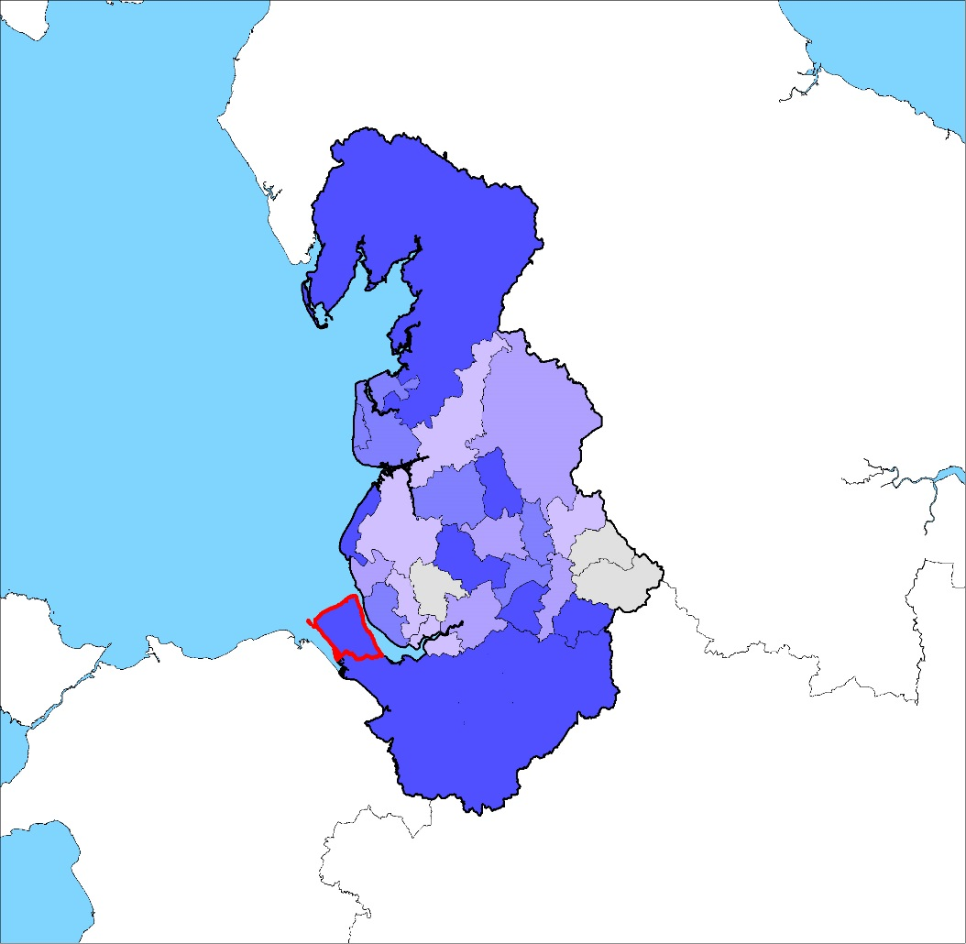
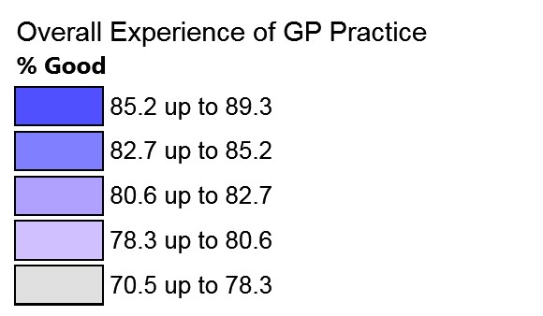
Overall experience: how the CCG’s results compare to other CCGs within the region
Q31. Overall, how would you describe your experience of your GP practice?
Percentage of patients saying ‘good’
Results range from
to
77%
87%
90%
The CCG represented by this pack is highlighted in red
Comparisons are indicative only: differences may not be statistically significant
Base: All those completing a questionnaire: CCG bases range from 1,466 to 8,516
Base: All those completing a questionnaire : CCC bases range from [insert smallest CCG base] to [insert largest CCG base]
%Good = %Very good + %Fairly good

Slide 11
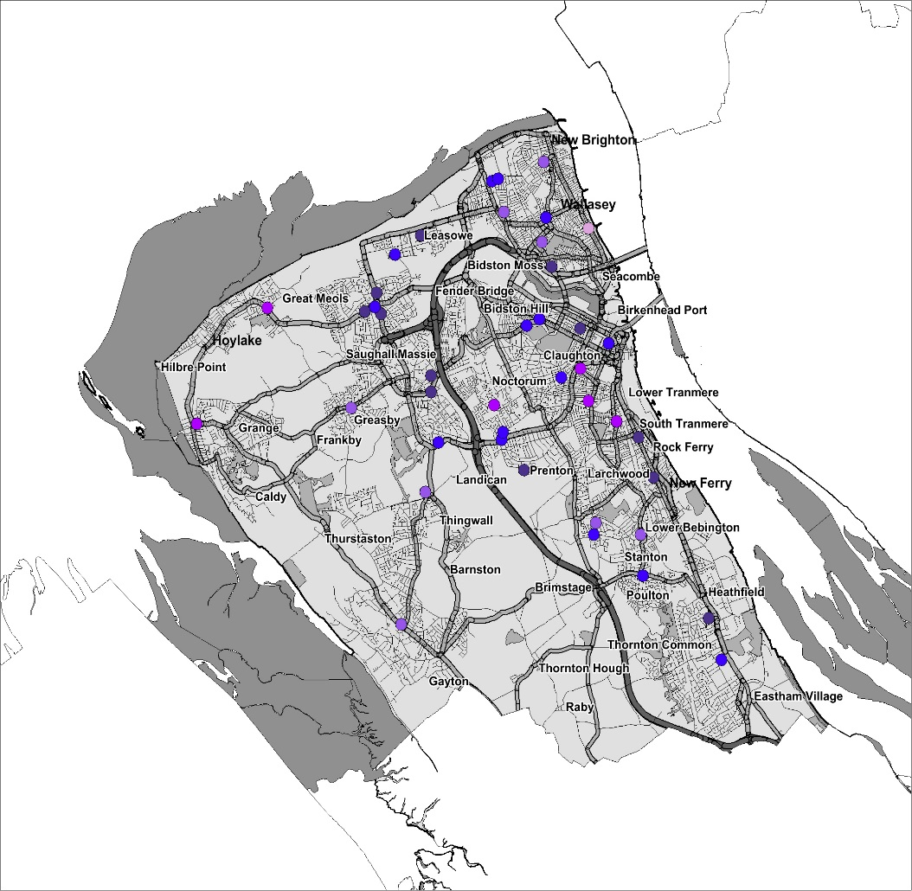
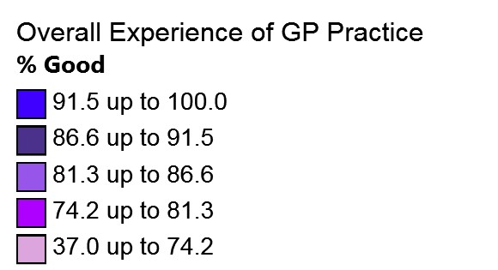
Overall experience: how the CCG’s practices compare
Q31. Overall, how would you describe your experience of your GP practice?
Percentage of patients saying ‘good’
Results range from
to
83% | (Practice X)
74%
100%
Comparisons are indicative only: differences may not be statistically significant
Base: All those completing a questionnaire: Practice bases range from 81 to 146
Base: All those completing a questionnaire : Practice bases range from [insert smallest Practice base] to [insert largest Practice base]
%Good = %Very good + %Fairly good

Slide 12
Overall experience: how the CCG’s practices compare
Q31. Overall, how would you describe your experience of your GP practice?
Percentage of patients saying ‘good’
Practices
CCG
National
Comparisons are indicative only: differences may not be statistically significant
Base: All those completing a questionnaire: National (710,945); CCG 2020 (5,271); Practice bases range from 81 to 146
%Good = %Very good + %Fairly good
Base: All those completing a questionnaire : Practice bases range from [insert smallest Practice base] to [insert largest Practice base]

Slide 13
Overall experience: how the CCG’s practices compare
Q31. Overall, how would you describe your experience of your GP practice?
Percentage of patients saying ‘good’
Practices
CCG
National
Comparisons are indicative only: differences may not be statistically significant
Base: All those completing a questionnaire: National (710,945); CCG 2020 (5,271); Practice bases range from 81 to 146
%Good = %Very good + %Fairly good
Base: All those completing a questionnaire : Practice bases range from [insert smallest Practice base] to [insert largest Practice base]

Slide 14
Local GP services

Slide 15
Ease of getting through to GP practice on the phone
Q1. Generally, how easy is it to get through to someone at your GP practice on the phone?
CCG’s results
CCG’s results over time
Comparison of results
CCG
National
71%
65%
Easy
Easy
29%
35%
Not easy
Not easy
Practice range within CCG – % Easy
CCG range within region – % Easy
Lowest Performing |  | Highest Performing
43% |  | 99%
Lowest Performing |  | Highest Performing
52% |  | 73%
Base: All those completing a questionnaire excluding 'Haven't tried': National (701,494); CCG 2020 (5,236); CCG 2019 (5,428); CCG 2018 (5,213); Practice bases range from 76 to 149; CCG bases range from 1,443 to 8,498
%Easy = %Very easy + %Fairly easy
%Not easy = %Not very easy + %Not at all easy

Slide 16
Ease of getting through to GP practice on the phone: how the CCG’s practices compare
Q1. Generally, how easy is it to get through to someone at your GP practice on the phone?
Percentage of patients saying it is ‘easy’ to get through to someone on the phone
Practices
CCG
National
Comparisons are indicative only: differences may not be statistically significant
Base: All those completing a questionnaire excluding ‘Haven’t tried’: National (701,494); CCG 2020 (5,236); Practice bases range from 76 to 149
%Easy = %Very easy + %Fairly easy
Base: All those completing a questionnaire : Practice bases range from [insert smallest Practice base] to [insert largest Practice base]

Slide 17
Ease of getting through to GP practice on the phone: how the CCG’s practices compare
Q1. Generally, how easy is it to get through to someone at your GP practice on the phone?
Percentage of patients saying it is ‘easy’ to get through to someone on the phone
Practices
CCG
National
Comparisons are indicative only: differences may not be statistically significant
Base: All those completing a questionnaire excluding ‘Haven’t tried’: National (701,494); CCG 2020 (5,236); Practice bases range from 76 to 149
%Easy = %Very easy + %Fairly easy
Base: All those completing a questionnaire : Practice bases range from [insert smallest Practice base] to [insert largest Practice base]

Slide 18
Helpfulness of receptionists at GP practice
Q2. How helpful do you find the receptionists at your GP practice?
CCG’s results
CCG’s results over time
Comparison of results
CCG
National
92%
89%
Helpful
Helpful
8%
11%
Not helpful
Not helpful
Practice range within CCG – % Helpful
CCG range within region – % Helpful
Lowest Performing |  | Highest Performing
79% |  | 100%
Lowest Performing |  | Highest Performing
85% |  | 93%
Base: All those completing a questionnaire excluding ‘Don’t know’: National (714,379); CCG 2020 (5,302); CCG 2019 (5,465); CCG 2018 (5,261); Practice bases range from 79 to 149; CCG bases range from 1,467 to 8,629
%Helpful = %Very helpful + %Fairly helpful
%Not helpful = %Not very helpful + %Not at all helpful

Slide 19
Helpfulness of receptionists at GP practice: how the CCG’s practices compare
Q2. How helpful do you find the receptionists at your GP practice?
Percentage of patients saying receptionists at the GP practice are ‘helpful’
Practices
CCG
National
Comparisons are indicative only: differences may not be statistically significant
Base: All those completing a questionnaire excluding ‘Don’t know’: National (714,379); CCG 2020 (5,302); Practice bases range from 79 to 149
Base: All those completing a questionnaire : Practice bases range from [insert smallest Practice base] to [insert largest Practice base]
%Helpful = %Very helpful + %Fairly helpful

Slide 20
Helpfulness of receptionists at GP practice: how the CCG’s practices compare
Q2. How helpful do you find the receptionists at your GP practice?
Percentage of patients saying receptionists at the GP practice are ‘helpful’
Practices
CCG
National
Comparisons are indicative only: differences may not be statistically significant
Base: All those completing a questionnaire excluding ‘Don’t know’: National (714,379); CCG 2020 (5,302); Practice bases range from 79 to 149
Base: All those completing a questionnaire : Practice bases range from [insert smallest Practice base] to [insert largest Practice base]
%Helpful = %Very helpful + %Fairly helpful

Slide 21
Access to online services

Slide 22
Awareness of online services
Q4. As far as you know, which of the following online services does your GP practice offer?
Practice range within CCG
Percentage aware of online services offered by GP practice
Comparisons are indicative only: differences may not be statistically significant
Base: All those completing a questionnaire: National (716,915); CCG 2020 (5,315); Practice bases range from 81 to 152

Slide 23
Online service use
Q5. Which of the following general practice online services have you used in the past 12 months?
Practice range within CCG
Percentage used online services in past 12 months
Comparisons are indicative only: differences may not be statistically significant
Base: All those completing a questionnaire: National (723,567); CCG 2020 (5,365); Practice bases range from 82 to 153

Slide 24
Ease of use of online services
Q6. How easy is it to use your GP practice’s website to look for information or access services?*
CCG’s results
CCG’s results over time
Comparison of results
CCG
National
83%
76%
Easy
Easy
17%
24%
Not easy
Not easy
Practice range within CCG – % Easy
CCG range within region – % Easy
Lowest Performing |  | Highest Performing
52% |  | 99%
Lowest Performing |  | Highest Performing
71% |  | 84%
*Those who say ‘Haven’t tried’ (62%) have been excluded from these results.
Base: All those completing a questionnaire excluding 'Haven't tried': National (273,048); CCG 2020 (1,927); CCG 2019 (1,833); CCG 2018 (1,581); Practice bases range from 11 to 60; CCG bases range from 565 to 3,419
%Easy = %Very easy + %Fairly easy
%Not easy = %Not very easy + %Not at all easy

Slide 25
Ease of use of online services: how the CCG’s practices compare
Q6. How easy is it to use your GP practice’s website to look for information or access services?
Percentage of patients saying it is ‘easy’ to use their GP practice’s website
Practices
CCG
National
Comparisons are indicative only: differences may not be statistically significant
Base: All those completing a questionnaire excluding 'Haven't tried': National (273,048); CCG 2020 (1,927); Practice bases range from 11 to 60
%Easy = %Very easy + %Fairly easy
Base: All those who got an appointment: Practice bases range from [insert smallest Practice base] to [insert largest Practice base]

Slide 26
Ease of use of online services: how the CCG’s practices compare
Q6. How easy is it to use your GP practice’s website to look for information or access services?
Percentage of patients saying it is ‘easy’ to use their GP practice’s website
Practices
CCG
National
Comparisons are indicative only: differences may not be statistically significant
Base: All those completing a questionnaire excluding 'Haven't tried': National (273,048); CCG 2020 (1,927); Practice bases range from 11 to 60
%Easy = %Very easy + %Fairly easy
Base: All those who got an appointment: Practice bases range from [insert smallest Practice base] to [insert largest Practice base]

Slide 27
Making an appointment

Slide 28
Choice of appointment
Q16. On this occasion (when you last tried to make a general practice appointment), were you offered a choice of appointment?
CCG’s results
CCG’s results over time
Comparison of results
CCG
National
61%
60%
Yes
Yes
39%
40%
No
No
Practice range within CCG – % Yes
CCG range within region – % Yes
Lowest Performing |  | Highest Performing
39% |  | 90%
Lowest Performing |  | Highest Performing
50% |  | 69%
Base: All who tried to make an appointment since being registered excluding ‘Can’t remember’ and ‘Doesn't apply’: National (564,341); CCG 2020 (4,100); CCG 2019 (4,245); CCG 2018 (4,108); Practice bases range from 53 to 114; CCG bases range from 1,181 to 6,807
%Yes = ‘a choice of place’ and/or ‘a choice of time or day’ and/or ‘a choice of healthcare professional’

Slide 29
Choice of appointment: how the CCG’s practices compare
Q16. On this occasion (when you last tried to make a general practice appointment), were you offered a choice of appointment?
Percentage of patients saying ‘yes’ they were offered a choice of appointment
Practices
CCG
National
Comparisons are indicative only: differences may not be statistically significant
Base: All who tried to make an appointment since being registered excluding ‘Can't remember’ and ‘Doesn’t apply’: National (564,341); CCG 2020 (4,100); Practice bases range from 53 to 114
%Yes = ‘a choice of place’ and/or ‘a choice of time or day’ and/or ‘a choice of healthcare professional’
Base: All those who got an appointment: Practice bases range from [insert smallest Practice base] to [insert largest Practice base]

Slide 30
Choice of appointment: how the CCG’s practices compare
Q16. On this occasion (when you last tried to make a general practice appointment), were you offered a choice of appointment?
Percentage of patients saying ‘yes’ they were offered a choice of appointment
Practices
CCG
National
Comparisons are indicative only: differences may not be statistically significant
Base: All who tried to make an appointment since being registered excluding ‘Can't remember’ and ‘Doesn’t apply’: National (564,341); CCG 2020 (4,100); Practice bases range from 53 to 114
%Yes = ‘a choice of place’ and/or ‘a choice of time or day’ and/or ‘a choice of healthcare professional’
Base: All those who got an appointment: Practice bases range from [insert smallest Practice base] to [insert largest Practice base]

Slide 31
Satisfaction with appointment offered
Q17. Were you satisfied with the type of appointment (or appointments) you were offered?
CCG’s results
CCG’s results over time
Comparison of results
CCG
National
76%
73%
Yes, took appt
Yes, took appt
18%
21%
No, took appt
No, took appt
6%
7%
No, didn’t take appt
No, didn’t take appt
Practice range within CCG – % Yes
CCG range within region – % Yes
Lowest Performing |  | Highest Performing
57% |  | 96%
Lowest Performing |  | Highest Performing
64% |  | 80%
Base: All who tried to make an appointment since being registered: National (678,039); CCG 2020 (4,998); CCG 2019 (5,186); CCG 2018 (4,949); Practice bases range from 70 to 143; CCG bases range from 1,404 to 8,159
%No = %No, but I still took an appointment +
%No, and I did not take an appointment

Slide 32
Satisfaction with appointment offered: how the CCG’s practices compare
Q17. Were you satisfied with the type of appointment (or appointments) you were offered?
Percentage of patients saying ‘yes’ they were satisfied with the appointment offered
Practices
CCG
National
Comparisons are indicative only: differences may not be statistically significant
Base: All who tried to make an appointment since being registered: National (678,039); CCG 2020 (4,998); Practice bases range from 70 to 143
Base: All those who got an appointment: Practice bases range from [insert smallest Practice base] to [insert largest Practice base]

Slide 33
Satisfaction with appointment offered: how the CCG’s practices compare
Q17. Were you satisfied with the type of appointment (or appointments) you were offered?
Percentage of patients saying ‘yes’ they were satisfied with the appointment offered
Practices
CCG
National
Comparisons are indicative only: differences may not be statistically significant
Base: All who tried to make an appointment since being registered: National (678,039); CCG 2020 (4,998); Practice bases range from 70 to 143
Base: All those who got an appointment: Practice bases range from [insert smallest Practice base] to [insert largest Practice base]

Slide 34
What patients do when they are not satisfied with the appointment offered and do not take it
Q19. What did you do when you did not take the appointment you were offered?
Of those who declined an appointment,
percentage who went on to do something else
Comparisons are indicative only: differences may not be statistically significant
Base: All who did not take the appointment offered (excluding those who haven't tried to make one): National (34,909); CCG 2020 (211)

Slide 35
Overall experience of making an appointment
Q22. Overall, how would you describe your experience of making an appointment?
CCG’s results
CCG’s results over time
Comparison of results
CCG
National
71%
65%
Good
Good
15%
17%
Poor
Poor
Practice range within CCG – % Good
CCG range within region – % Good
Lowest Performing |  | Highest Performing
46% |  | 96%
Lowest Performing |  | Highest Performing
57% |  | 72%
Base: All who tried to make an appointment since being registered: National (670,827); CCG 2020 (4,941); CCG 2019 (5,112); CCG 2018 (4,873); Practice bases range from 68 to 137; CCG bases range from 1,390 to 8,057
%Good = %Very good + %Fairly good
%Poor = %Very poor + %Fairly poor

Slide 36
Overall experience of making an appointment: how the CCG’s practices compare
Q22. Overall, how would you describe your experience of making an appointment?
Percentage of patients saying they had a ‘good’ experience of making an appointment
Practices
CCG
National
Comparisons are indicative only: differences may not be statistically significant
Base: All who tried to make an appointment since being registered: National (670,827); CCG 2020 (4,941); Practice bases range from 68 to 137
Base: All those completing a questionnaire : Practice bases range from [insert smallest Practice base] to [insert largest Practice base]
%Good = %Very good + %Fairly good

Slide 37
Overall experience of making an appointment: how the CCG’s practices compare
Q22. Overall, how would you describe your experience of making an appointment?
Percentage of patients saying they had a ‘good’ experience of making an appointment
Practices
CCG
National
Comparisons are indicative only: differences may not be statistically significant
Base: All who tried to make an appointment since being registered: National (670,827); CCG 2020 (4,941); Practice bases range from 68 to 137
Base: All those completing a questionnaire : Practice bases range from [insert smallest Practice base] to [insert largest Practice base]
%Good = %Very good + %Fairly good

Slide 38
Perceptions of care at patients’ last appointment

Slide 39
Perceptions of care at patients’ last appointment with a healthcare professional
Q26. Last time you had a general practice appointment, how good was the healthcare professional at each of the following
CCG’s results
Nationl results % Poor (total)
National results
% ‘Poor’ (total)
4% | 4% | 4%
CCG results
% Poor (total)
CCG results
% ‘Poor’ (total)
2% | 3% | 3%
Giving you enough time
Listening to you
Treating you with care and concern
Very poor
Very good
Base: All who had an appointment since being registered with current GP practice excluding 'Doesn't apply': National (678,664; 676,845; 676,130); CCG 2020 (5,039; 5,032; 5,018)
%Poor (total) = %Very poor + %Poor

Slide 40
Perceptions of care at patients’ last appointment with a healthcare professional
Q28-30. During your last general practice appointment…
CCG’s results
Nationl results % Poor (total)
National results
% ‘No, not at all’
7% | 5% | 6%
CCG results
% Poor (total)
CCG results
% ‘No, not at all’
5% | 3% | 4%
Felt involved in decisions about care and treatment
Had confidence and trust in the healthcare professional
Felt their needs were met
No, not at all
Yes, definitely
Base: All who had an appointment since being registered with current GP practice excluding ‘Don’t know / doesn’t apply’ or ‘Don’t know / can’t say’: National (603,943; 667,229; 663,675); CCG 2020 (4,563; 4,982; 4,949)

Slide 41
Mental health needs recognised and understood
Q27. During your last general practice appointment, did you feel that the healthcare professional recognised and/or understood any mental health needs that you might have had?
CCG’s results
CCG’s results over time
Comparison of results
CCG
National
89%
85%
Yes
Yes
11%
15%
No
No
Practice range within CCG – % Yes
CCG range within region – % Yes
Lowest Performing |  | Highest Performing
76% |  | 100%
Lowest Performing |  | Highest Performing
84% |  | 91%
Base: All who had an appointment since being registered with current GP practice excluding ‘I did not have any mental health needs’ and ‘Did not apply to my last appointment’: National (277,005); CCG 2020 (2,043); CCG 2019 (2,102); CCG 2018 (2,091); Practice bases range from 26 to 63; CCG bases range from 554 to 3,765
%Yes = %Yes, definitely + %Yes, to some extent

Slide 42
Managing health conditions

Slide 43
Support with managing long-term conditions, disabilities, or illnesses
Q38. In the last 12 months, have you had enough support from local services or organisations to help you to manage your condition (or conditions)?
CCG’s results
CCG’s results over time
Comparison of results
CCG
National
79%
77%
Yes
Yes
21%
23%
No
No
Practice range within CCG – % Yes
CCG range within region – % Yes
Lowest Performing |  | Highest Performing
64% |  | 92%
Lowest Performing |  | Highest Performing
73% |  | 82%
Base: All with a long-term condition excluding ‘I haven’t needed support’ and ‘Don’t know / can’t say’: National (279,703); CCG 2020 (2,356); CCG 2019 (2,409); CCG 2018 (2,300); Practice bases range from 30 to 70; CCG bases range from 644 to 3,830
%Yes = %Yes, definitely + %Yes, to some extent

Slide 44
Support with managing long-term conditions, disabilities, or illnesses: how the CCG’s practices compare
Q38. In the last 12 months, have you had enough support from local services or organisations to help you to manage your condition (or conditions)?
Percentage of patients saying ‘yes’ they have had enough support to manage their condition(s)
Practices
CCG
National
Comparisons are indicative only: differences may not be statistically significant
Base: All with a long-term condition excluding ‘I haven’t needed support’ and ‘Don’t know / can’t say’: National (279,703); CCG 2020 (2,356); Practice bases range from 30 to 70
%Yes = %Yes, definitely + %Yes, to some extent
Base: All those who got an appointment: Practice bases range from [insert smallest Practice base] to [insert largest Practice base]

Slide 45
Support with managing long-term conditions, disabilities, or illnesses: how the CCG’s practices compare
Q38. In the last 12 months, have you had enough support from local services or organisations to help you to manage your condition (or conditions)?
Percentage of patients saying ‘yes’ they have had enough support to manage their condition(s)
Practices
CCG
National
Comparisons are indicative only: differences may not be statistically significant
Base: All with a long-term condition excluding ‘I haven’t needed support’ and ‘Don’t know / can’t say’: National (279,703); CCG 2020 (2,356); Practice bases range from 30 to 70
%Yes = %Yes, definitely + %Yes, to some extent
Base: All those who got an appointment: Practice bases range from [insert smallest Practice base] to [insert largest Practice base]

Slide 46
Satisfaction with general practice appointment times

Slide 47
Satisfaction with appointment times
Q8. How satisfied are you with the general practice appointment times that are available to you?*
CCG’s results
CCG’s results over time
Comparison of results
CCG
National
68%
63%
Satisfied
Satisfied
15%
19%
Dissatisfied
Dissatisfied
Practice range within CCG – % Satisfied
CCG range within region – % Satisfied
Lowest Performing |  | Highest Performing
42% |  | 98%
Lowest Performing |  | Highest Performing
56% |  | 70%
*Those who say ‘I’m not sure when I can get an appointment’ (2%) have been excluded from these results.
Base: All those completing a questionnaire excluding ‘I’m not sure when I can get an appointment’: National (663,563); CCG 2020 (4,933); CCG 2019 (5,071); CCG 2018 (4,913); Practice bases range from 66 to 146; CCG bases range from 1,355 to 8,078
%Satisfied = %Very satisfied + %Fairly satisfied
%Dissatisfied = %Very dissatisfied + %Fairly dissatisfied

Slide 48
Satisfaction with appointment times: how the CCG’s practices compare
Q8. How satisfied are you with the general practice appointment times that are available to you?
Percentage of patients saying they are ‘satisfied’ with the appointment times available
Practices
CCG
National
Comparisons are indicative only: differences may not be statistically significant
Base: All those completing a questionnaire excluding ‘I’m not sure when I can get an appointment’: National (663,563); CCG 2020 (4,933); Practice bases range from 66 to 146
Base: All those completing a questionnaire : Practice bases range from [insert smallest Practice base] to [insert largest Practice base]
%Satisfied = %Very satisfied + %Fairly satisfied

Slide 49
Satisfaction with appointment times: how the CCG’s practices compare
Q8. How satisfied are you with the general practice appointment times that are available to you?
Percentage of patients saying they are ‘satisfied’ with the appointment times available
Practices
CCG
National
Comparisons are indicative only: differences may not be statistically significant
Base: All those completing a questionnaire excluding ‘I’m not sure when I can get an appointment’: National (663,563); CCG 2020 (4,933); Practice bases range from 66 to 146
Base: All those completing a questionnaire : Practice bases range from [insert smallest Practice base] to [insert largest Practice base]
%Satisfied = %Very satisfied + %Fairly satisfied

Slide 50
Services when GP practice is closed
The services when GP practice is closed questions are only asked of those who have recently used an NHS service when they wanted to see a GP but their GP practice was closed. As such, the base size is often too small to make meaningful comparisons at practice level; practice range within CCG has therefore not been included for these questions.
Please note that patients cannot always distinguish between out-of-hours services and extended access appointments. Please view the results in this section with the configuration of your local services in mind.

Slide 51
Use of services when GP practice is closed
Q45. Considering all of the services you contacted, which of the following happened on that occasion?
Base: All those who have contacted an NHS service when GP practice closed in past 12 months: National (133,689); CCG 2020 (868)

Slide 52
Time taken to receive care or advice when GP practice is closed
Q46. How do you feel about how quickly you received care or advice on that occasion?
CCG’s results
CCG’s results over time
Comparison of results
CCG
National
58%
63%
About right
About right
42%
37%
Took too long
Took too long
CCG range within region – % About right
Lowest Performing |  | Highest Performing
55% |  | 77%
Base: All those who tried to contact an NHS service when GP surgery closed in past 6 months excluding ‘Don’t know / doesn’t apply’: National (124,765); CCG 2020 (834); CCG 2019 (995); CCG 2018 (984); CCG bases range from 263 to 1,450

Slide 53
Confidence and trust in staff providing services when GP practice is closed
Q47. Considering all of the people that you saw or spoke to on that occasion, did you have confidence and trust in them?
CCG’s results
CCG’s results over time
Comparison of results
CCG
National
93%
91%
Yes
Yes
7%
9%
No
No
CCG range within region – % Yes
Lowest Performing |  | Highest Performing
85% |  | 96%
Base: All those who tried to contact an NHS service when GP surgery closed in past 6 months excluding ‘Don’t know / can't say’: National (125,059); CCG 2020 (805); CCG 2019 (1,020); CCG 2018 (1,006); CCG bases range from 273 to 1,472
%Yes = %Yes, definitely + % Yes, to some extent

Slide 54
Overall experience of services when GP practice is closed
Q48. Overall, how would you describe your last experience of NHS services when you wanted to see a GP but your GP practice was closed?
CCG’s results
CCG’s results over time
Comparison of results
CCG
National
70%
67%
Good
Good
14%
16%
Poor
Poor
CCG range within region – % Good
Lowest Performing |  | Highest Performing
59% |  | 77%
Base: All those who tried to contact an NHS service when GP surgery closed in past 6 months excluding ‘Don’t know / can't say’: National (128,756); CCG 2020 (854); CCG 2019 (1,019); CCG 2018 (1,002); CCG bases range from 281 to 1,529
%Good = %Very good + %Fairly good %Poor = %Fairly poor + %Very poor

Slide 55
Statistical reliability

Slide 56
Statistical reliability
Participants in a survey such as GPPS represent only a sample of the total population of interest – this means we cannot be certain that the results of a question are exactly the same as if everybody within that population had taken part (“true values”). However, we can predict the variation between the results of a question and the true value by using the size of the sample on which results are based and the number of times a particular answer is given. The confidence with which we make this prediction is usually chosen to be 95% – that is, the chances are 95 in 100 that the true value will fall within a specified range (the “95% confidence interval”).
The table below gives examples of what the confidence intervals look like for an ‘average’ practice and CCG, as well as the confidence intervals at the national level.
An example of confidence intervals (at national, CCG and practice level) based on the average number of responses to the question “Overall, how would you describe your experience of your GP practice?”
 | Average sample size on which results are based | Approximate confidence intervals for percentages at or near these levels (expressed in percentage points)
 |  | Level 1: 10% or 90% | Level 2: 30% or 70% | Level 3: 50%
 |  | +/- | +/- | +/-
National | 739,637 | 0.10 | 0.15 | 0.17
CCG | 5,479 | 1.13 | 1.73 | 1.88
Practice | 108 | 6.93 | 10.20 | 11.08
For example, taking a CCG where 5,479 people responded and where 30% answered ‘Very good’ in response to ‘Overall, how would you describe your experience of making an appointment’, there is a 95% likelihood that the true value (which would have been obtained if the whole population had been interviewed) will fall within the range of +/-1.73 percentage points from that question’s result (i.e. between 28.27% and 31.73%).
When results are compared between separate groups within a sample, the difference may be “real” or it may occur by chance (because not everyone in the population has been interviewed). Confidence intervals will be wider when the results for a group are based on smaller numbers i.e. practices where 100 patients or fewer responded to a question. These findings should be regarded as indicative rather than robust.

Slide 57
Want to know more?

Slide 58
Further background information about the survey
The survey was sent to c.2.3 million adult patients registered with a GP practice.
Participants are sent a postal questionnaire, also with the option of completing the survey online or via telephone.
The survey has been running since 2007 and presents results for all practices in England (where surveys have been completed and returned). From 2017 the survey has been annual; previously it ran twice a year (June 2011 – July 2016), on a quarterly basis (April 2009 – March 2011) and annually (January 2007 – March 2009).
For more information about the survey please visit https://gp-patient.co.uk/.
The overall response rate to the survey is 31.7%, based on 739,637 completed surveys.
Weights have been applied to adjust the data to account for potential age and gender differences between the profile of all eligible patients in a practice and the patients who actually complete a questionnaire. Since the first wave of the 2011-2012 survey the weighting also takes into account neighbourhood statistics, such as levels of deprivation, in order to further improve the reliability of the findings.
Further information on the survey including questionnaire design, sampling, communication with patients and practices, data collection, data analysis, response rates and reporting can be found in the technical annex for each survey year, available here: https://gp-patient.co.uk/surveysandreports.
c.2.3m
Surveys to adults registered with an English GP practice
739,637
Completed surveys in the 2020 publication
31.7% National response rate

Slide 59
Where to go to do further analysis …
For reports which show the National results broken down by CCG and Practice, go to
https://gp-patient.co.uk/surveysandreports - you can also see previous years’ results here.
To look at this year’s survey data at a national, CCG or practice level, and filter on a specific participant group (e.g. by age), break down the survey results by survey question, or to create and compare different participant ‘subgroups’, go to https://gp-patient.co.uk/analysistool/2020.
To look at results over time, and filter on a specific participant group, go to https://gp-patient.co.uk/analysistool/trends.
For general FAQs about the GP Patient Survey, go to https://gp-patient.co.uk/faq.

Slide 60
For further information about the GP Patient Survey, please get in touch with the GPPS team at Ipsos MORI at GPPatientSurvey@ipsos.com
We would be interested to hear any feedback you have on this slide pack, so we can make improvements for the next publication.

