Slide 1



Unpacking the 2024 gp patient survey: insights for primary care
Ipsos
18 July 2024
© Ipsos | GPPS Webinar | July 2024 | Version 1 | Public

Slide 2

Welcome and introductions
This session is being recorded
Please submit questions using the chat function
    We will share answers by email after the session
Or email us afterwards: gppatientsurvey@ipsos.com

Slide 3
Agenda
About GPPS
2024 results
How to find and use results
Where to go for more help & feedback

Slide 4
About GPPS

Slide 5
GPPS 2024 in numbers
2.55 million patients selected
6,307 practices
699,790 took part
27.3% response rate
564,208 took part online
16,425 helpline calls
2,392 email queries
1,919 letter responses
9,322 took part using a
language other than English
1,277 took part via the telephone helpline
335 used the BSL version
117 large print requests
1 Braille request

Slide 6
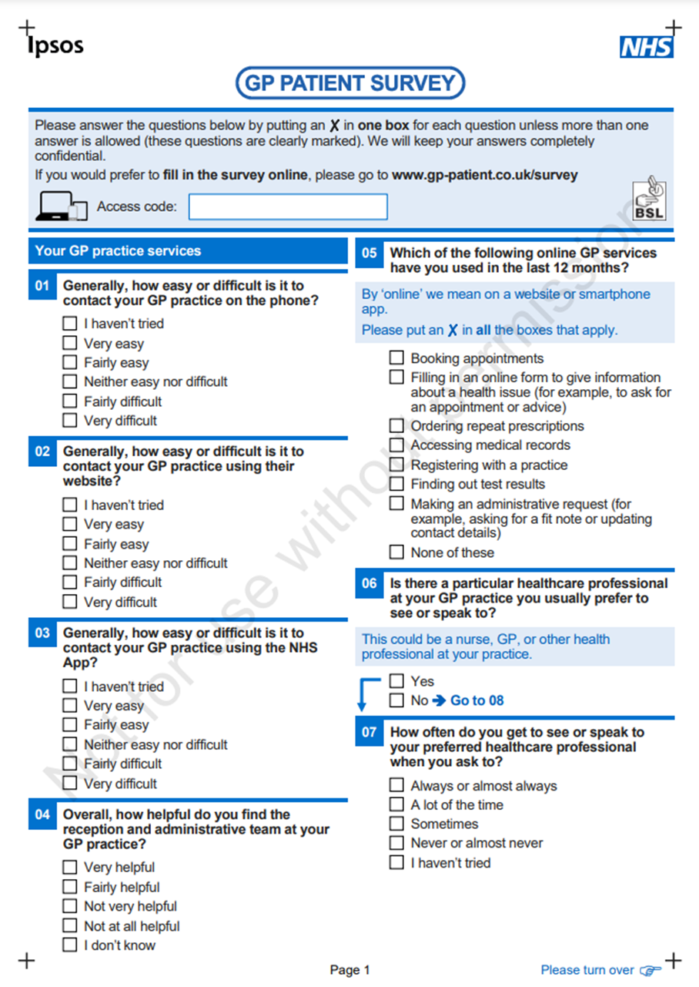
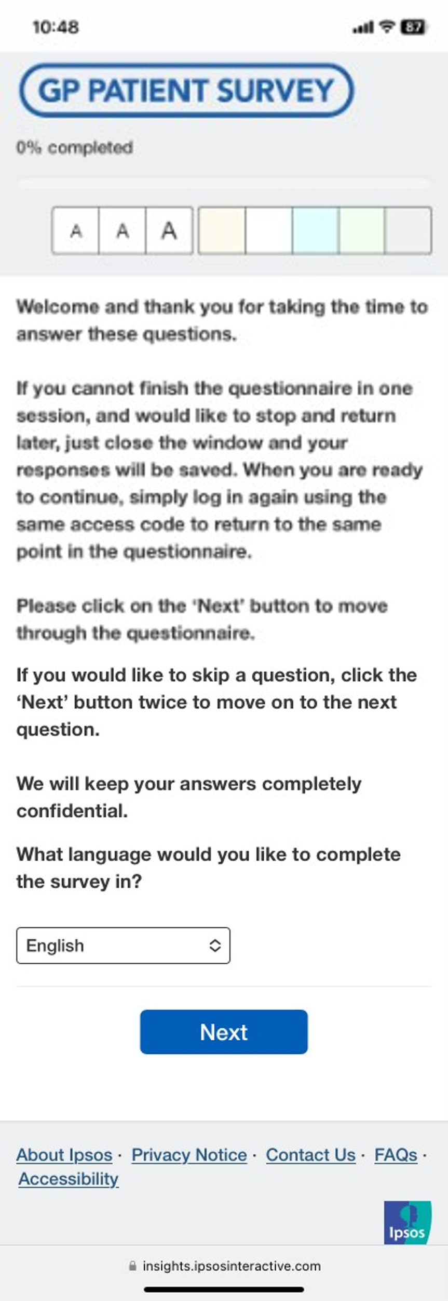
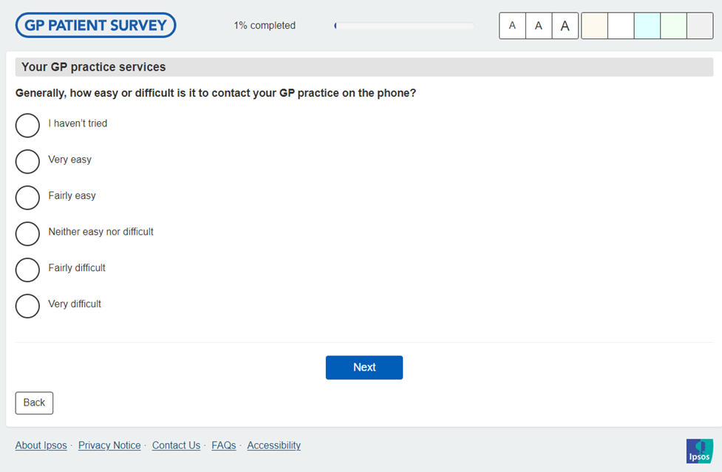

People can take part online or by paper
Paper questionnaire
Online (including desktop, tablet and mobile formats)

Slide 7
GPPS through the years
2007-2013
DHSC
2013-present
NHS England
2007-2008
Annual
2009-2010
Quarterly
2011-2017
Biannual
2017-present
Annual
2007
2-pages
2008
4-pages
2009-present
8-pages
2007
2-pages
2008
4-pages
2009
Q redevelopment
2012
Questionnaire redevelopment
2018
Questionnaire redevelopment
2007-2011
Sample design to measure QOF metrics
2012-present
Sample design to provide equal CIs for practices
2021-present
Sample from PDS
2007-2023
Paper questionnaire in every mailing
2021-present
+ text messages

Slide 8
2024 – the start of a new time series
Survey method
Questionnaire content
Online first approach
Paper questionnaire in final mailing only
Aim to reduce costs and improve data quality
Changes in how primary care services are delivered and how patients experience them

Slide 9




Contact strategy
January
Letter with invitation and details to complete survey online
Text message (+1 week)
Early February
E-letter
OR Letter if no mobile number
Text message (+1 week)
Late February
Letter with paper questionnaire
Text message (+1 week)
Sequential push-to-web
+3 wks
+3 wks

Slide 10
Response rates and online response over time
% taking part online
Response rate

Slide 11
How people are selected to take part
Random probability survey
Gold standard in survey research
Means we only need to invite a small number from each practice
Eligible patients
16 or over
Registered with GP practice for at least 6 months
Must be invited to take part
Data is weighted
For analysis, we add weights to correct for unequal probability of selection and response and to the profile of the population

Slide 12
GPPS 2024 results

Slide 13

2024 Questionnaire content
Your GP practice services
Your last contact
Your last appointment
Overall experience
When your GP practice is closed
Your health
Pharmacy
Dentistry
Some questions about you (Demographics)

Slide 14
Had a good overall experience…

Slide 15
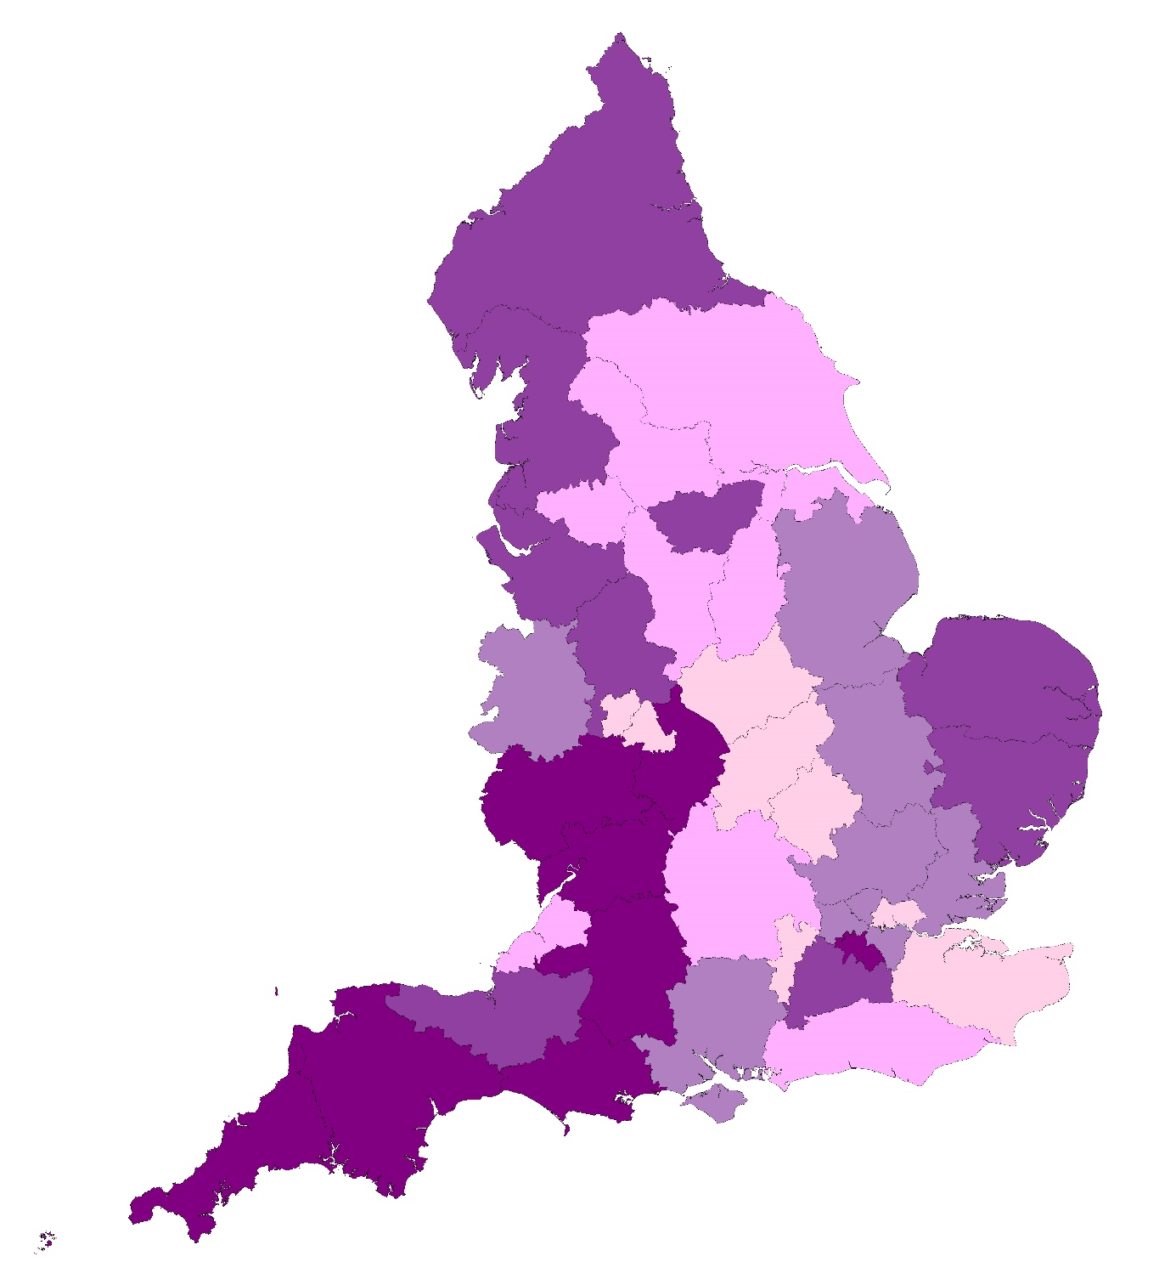
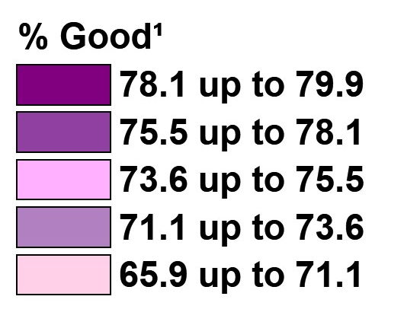
Overall experience of GP practice
Q32. Overall, how would you describe your experience of your GP practice?
¹Good = ‘very good’ and ‘fairly good’. ²Poor = ‘very poor’ and ‘fairly poor’. Base: asked of all patients: 2024 (693,982).

Slide 16
Access: Ease of contacting GP practice
50%
easy on the phone
48%
easy using practice website
45%
easy using the NHS App
¹Tried to contact GP practice on the phone/website/NHS App = ‘very easy’ and ‘fairly easy’ and ‘neither easy nor difficult’ and ‘fairly difficult’ and ‘very difficult’. ²Easy = ‘very easy’ and ‘fairly easy’. ³Difficult = ‘very difficult’ and ‘fairly difficult’. Base: asked of all patients, excluding those who said ‘I haven’t tried’: Phone (661,424), Website (315,087), NHS App (220,709)

Slide 17
Access: Helpfulness of reception and administrative team
Q4. Overall, how helpful do you find the reception and administrative team at your GP practice?
Most positive
Older people
Carers, 50+ hours a week
Has a long-term condition
Least positive
Pakistani and Bangladeshi backgrounds
¹Helpful = ‘very helpful’ and ‘fairly helpful’. ²Not helpful = ‘not very helpful’ and ‘not at all helpful’.
Base: asked of all patients, excluding those who said ‘I don’t know’: 2024 (675,643).

Slide 18
Variation in experience by demographics
Gender/Gender identity same as sex at birth
Smoking status
Age
Sexuality
Ethnicity
Religion
Carer status
Long-term condition
Disability
Work status
Parent or guardian
Index of Multiple Deprivation

Slide 19
Last contact
Q10. Still thinking about the last time you contacted your GP practice, how did you try to contact them?
Phoned
Aged 75+
Pakistani, Gypsy or Irish Traveller
Carer 50+ hours week
Online
Age 16-54
Non-binary
Roma, Chinese, White and Asian
Carer <9 hours week
Base: asked of patients who have tried to contact their GP practice since being registered: 2024 (675,534).

Slide 20
Last contact: Knew next steps
Base: all patients who have tried to contact their GP practice since being registered, excluding those who did not provide details of their last contact : 2024 (634,131).

Slide 21
Last appointment
Q22. How did the appointment take place?
Q23. Who did you have the appointment with?
29%
over the
phone
69%
face-to-face
64.8% A GP
22.4% A nurse
8.1% Another healthcare professional
4.7% I don’t know
2% other
Base: asked of patients who had an appointment since being registered with current GP practice: 2024 (666,169).
Base: asked of patients who had an appointment since being registered with current GP practice: 2024 (666,147).

Slide 22
Last appointment
92%
said they had confidence and trust in the healthcare professional
90%
said their needs were met
85%
said the healthcare professional was good at treating them with care and concern
Base: asked of patients who had an appointment since being registered with current GP practice, excluding those who said 'I don't know or it didn't apply’: Confidence and trust (656,379), Needs met (657,398), Care and concern (661,177)

Slide 23
Pharmacy services
Q47. Thinking about the last 12 months, which of the following services have you used a pharmacy for? (multiple responses allowed)
Q48. How would you describe your experience of using these pharmacy services?
87%
good
¹Used any pharmacy service = all except ‘None of these’. Base: asked of all patients: 2024 (694,064).
Base: asked of all patients who have used a pharmacy for one of the services named in Q47 in the last 12 months: 2024 (625,567).

Slide 24
Reporting

Slide 25
How can you use GPPS?
Compare organisations:
Results available at practice, PCN and ICS level
Fieldwork is always Jan-March
Understand the needs and experiences of specific groups:
Extensive demographic information from participants and large sample sizes allow for detailed analysis
Analyse trends from 2025:
Identify areas for improvement and see where things are getting better

Slide 26
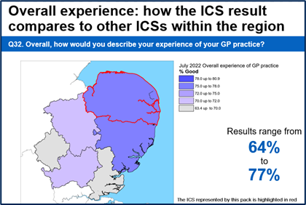
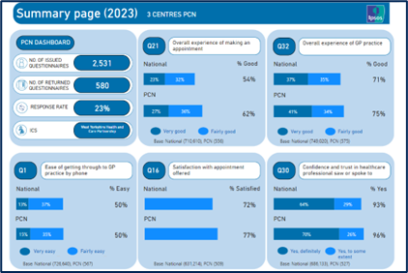
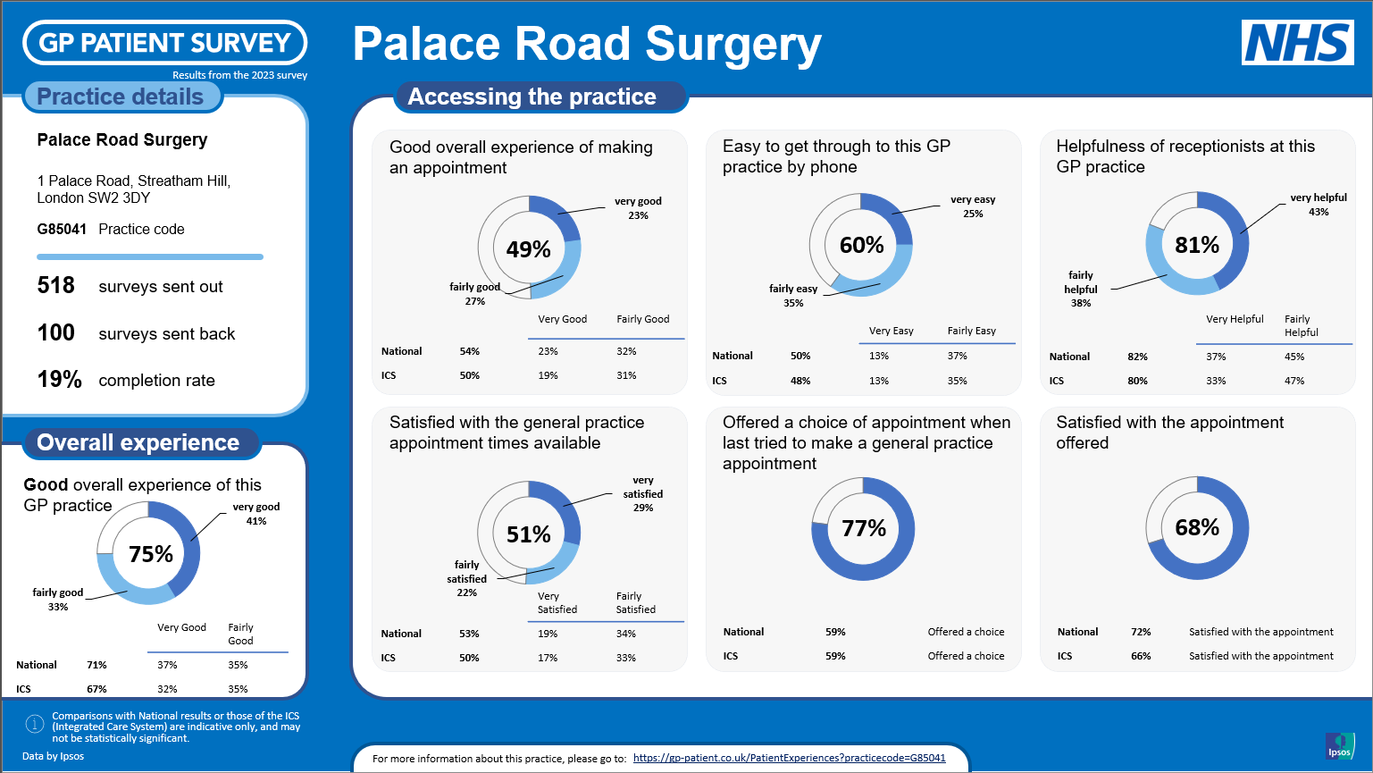
How can you … compare organisations?
ICS slidepacks
gp-patient.co.uk/ICSslidepacks2024
PCN tool
gp-patient.co.uk/pcn-dashboard
Practice pages and summary
gp-patient.co.uk/practices-search

Slide 27
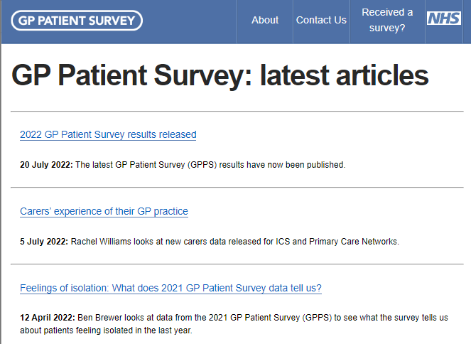
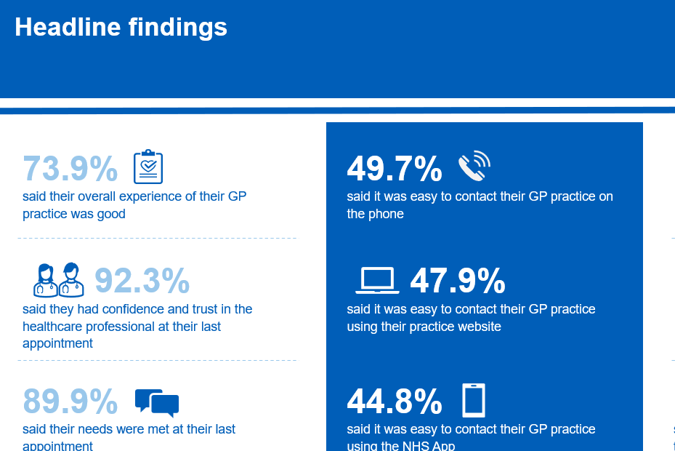
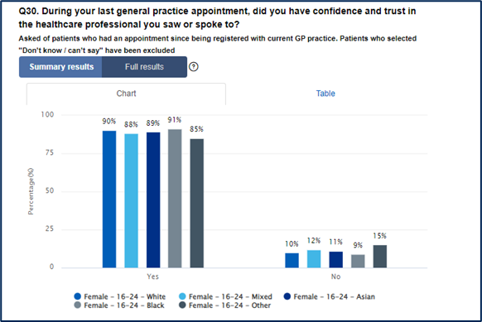
How can you … look at health inequalities?
Using the …
COMING IN SEPTEMBER 2024
GPPS latest articles
gp-patient.co.uk/Master%20Blog%20List
National report
gp-patient.co.uk/surveysandreports
Analysis tool
gp-patient.co.uk/analysistool

Slide 28
Keep in touch!
Let us know how you are using the data – so we can understand the uses of the data, and share good practice with others
Get in touch with any feedback – so we can continue to improve the survey and its outputs, to better meet your needs
Let us know if you want any more information – if you would like more information about the survey, please get in touch
Email us at gppatientsurvey@ipsos.com

Slide 29
THANK
YOU
CONTACT US:
GPPatientSurvey@Ipsos.com
eileen.irvin@ipsos.com
molly.dawson@ipsos.com
rachel.williams@ipsos.com

